Slide 1
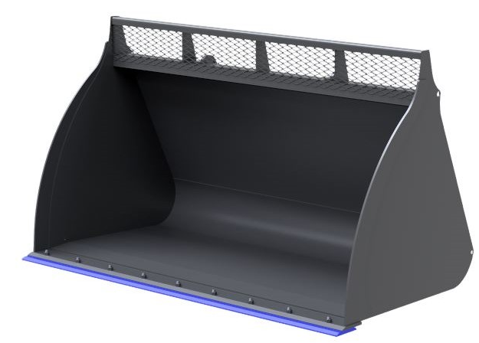
WOOD CHIP
BUCKETS
FEATURES
High capacity for handling dry wood chip
3.00m3 & 3.50m3 options
6mm shell
Full height brackets
Brackets welded to fully wrapped support straps
HB500 boron heat treated cutting edge
HB500 boron heat treated heel pads
HB500 boron heat treated bolt on reversible toe plate
WHITES MATERIAL HANDLING
17 - 19 EMERY ROAD
BRISTOL
BS4 5PF
0117 972 0006
WWW.WHITESMH.CO.UK
SALES@WHITESMH.CO.UK

