Slide 1
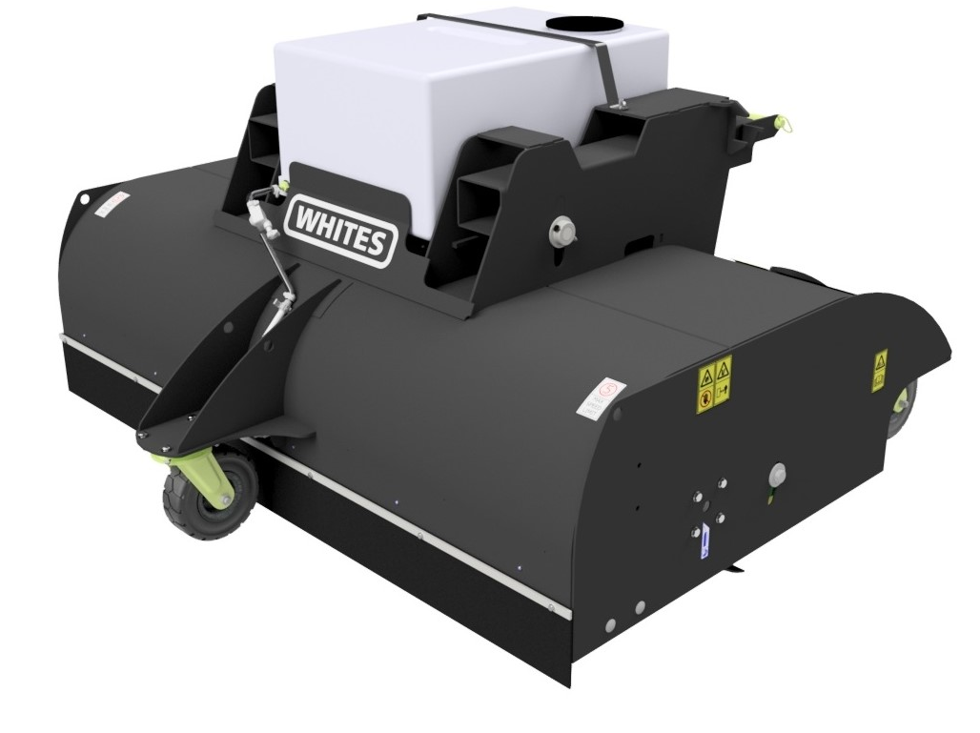
SWEEPER
COLLECTOR
FEATURES
2000mm / 2200mm Sweeping width Models
Operates from a single hydraulic service
Floating fork pockets
3 x Heavy duty speed rated offroad wheels
Direct drive motor inc pressure relief valve 40-100 lpm @ 250 bar
Gravity fed water system
Simple, quick adjustment of brush height
508mm Diameter poly brush segments
Optional side brush
Optional Carriage / Coupler mounting
WHITES MATERIAL HANDLING
17 - 19 EMERY ROAD
BRISTOL
BS4 5PF
0117 972 0006
WWW.WHITESMH.CO.UK
SALES@WHITESMH.CO.UK

Slide 2
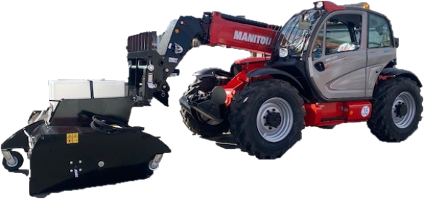
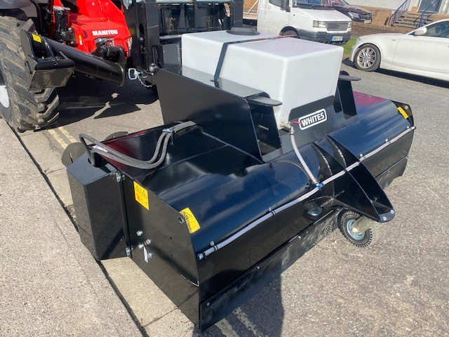
SWEEPER
COLLECTOR
Model | Sweeping Width | Overall Width | Pick Up | Wheels | Bristle ⌀
SC2000FM | 2000mm | 2350mm | Fork Mounted | 3 | 508mm
SC2200FM | 2200mm | 2567mm | Fork Mounted | 3 | 508mm
WHITES MATERIAL HANDLING
17 - 19 EMERY ROAD
BRISTOL
BS4 5PF
0117 972 0006
WWW.WHITESMH.CO.UK
SALES@WHITESMH.CO.UK

