Slide 1
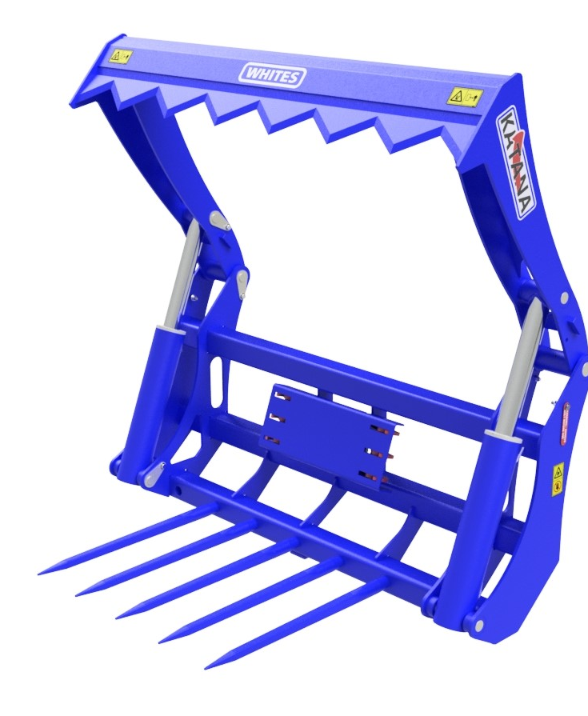
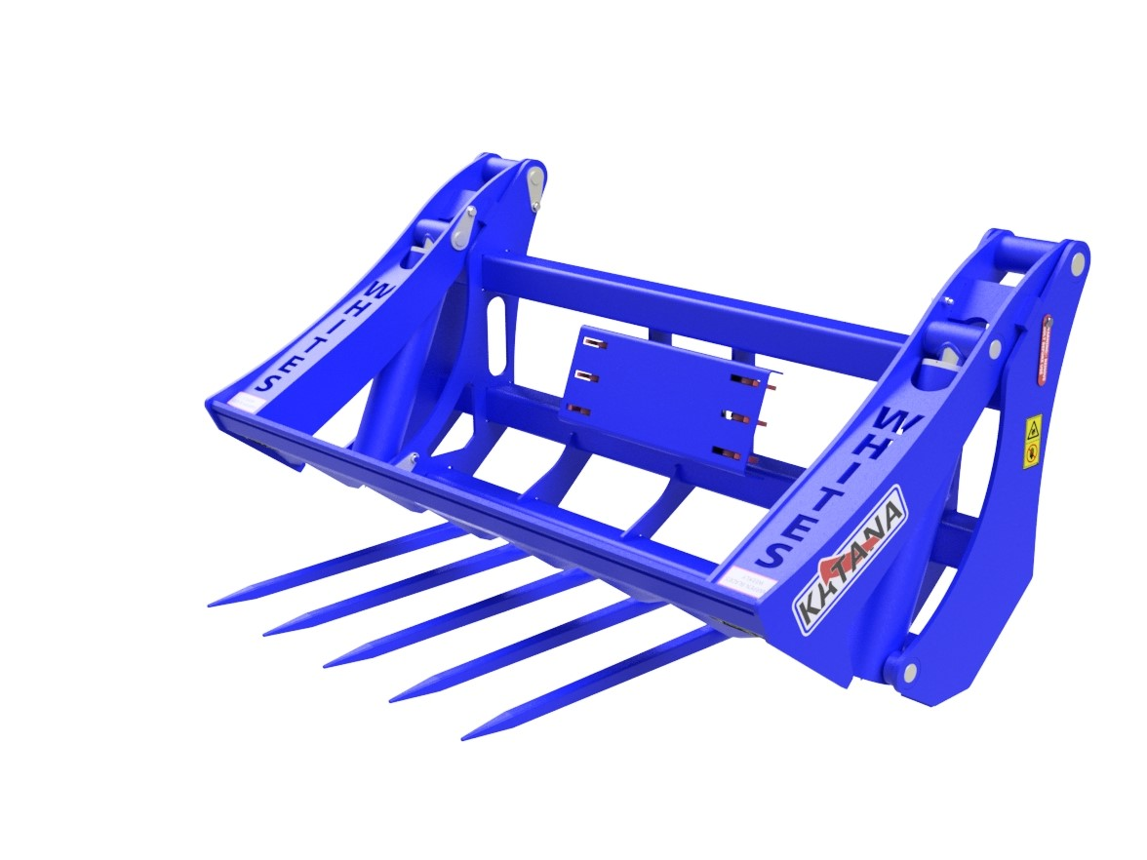
KATANA
BALE
SLICE
FEATURES
Cut bale and remove wrap from the cab
Unique bale retention claws
Retention claw contour to bale shape
Sequence valve operation; only 1 service req.
Hardox teeth
High powered rams ensure easy, clean cut
Vertical wraps provide more powerful action
Underside HB500 wear pads
High grade pins
Bolt on brackets
490kg; suitable for Tractor Loaders & Telehandlers
WHITES MATERIAL HANDLING
17 - 19 EMERY ROAD
BRISTOL
BS4 5PF
0117 972 0006
WWW.WHITESMH.CO.UK
SALES@WHITESMH.CO.UK

