Slide 1
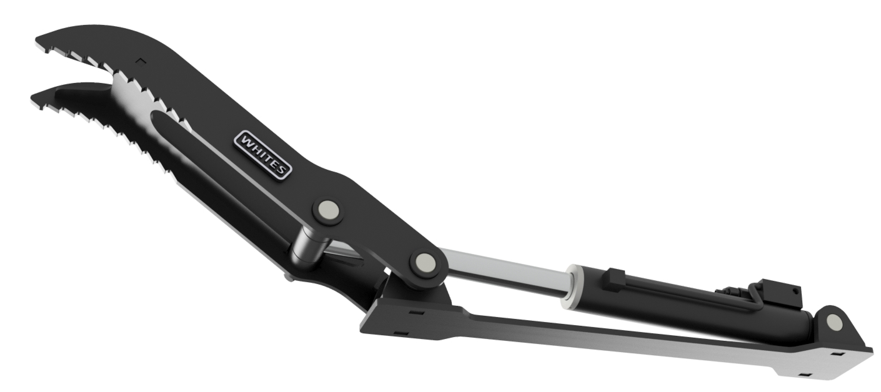
HYDRAULIC
THUMBS
FEATURES
Pressure relief valve
Universal fitment
Large rotational angle
Folds back when not in use
Model | Weight Range | RRP (£)
TH15 | 1-2 TONNE | £850.00
TH30 | 2-4 TONNE | £995.00
TH50 | 4-6 TONNE | £1213.00
TH70 | 6-9 TONNE | £1530.00
WHITES MATERIAL HANDLING
17 - 19 EMERY ROAD
BRISTOL
BS4 5PF
0117 972 0006
WWW.WHITESMH.CO.UK
SALES@WHITESMH.CO.UK

