Slide 1
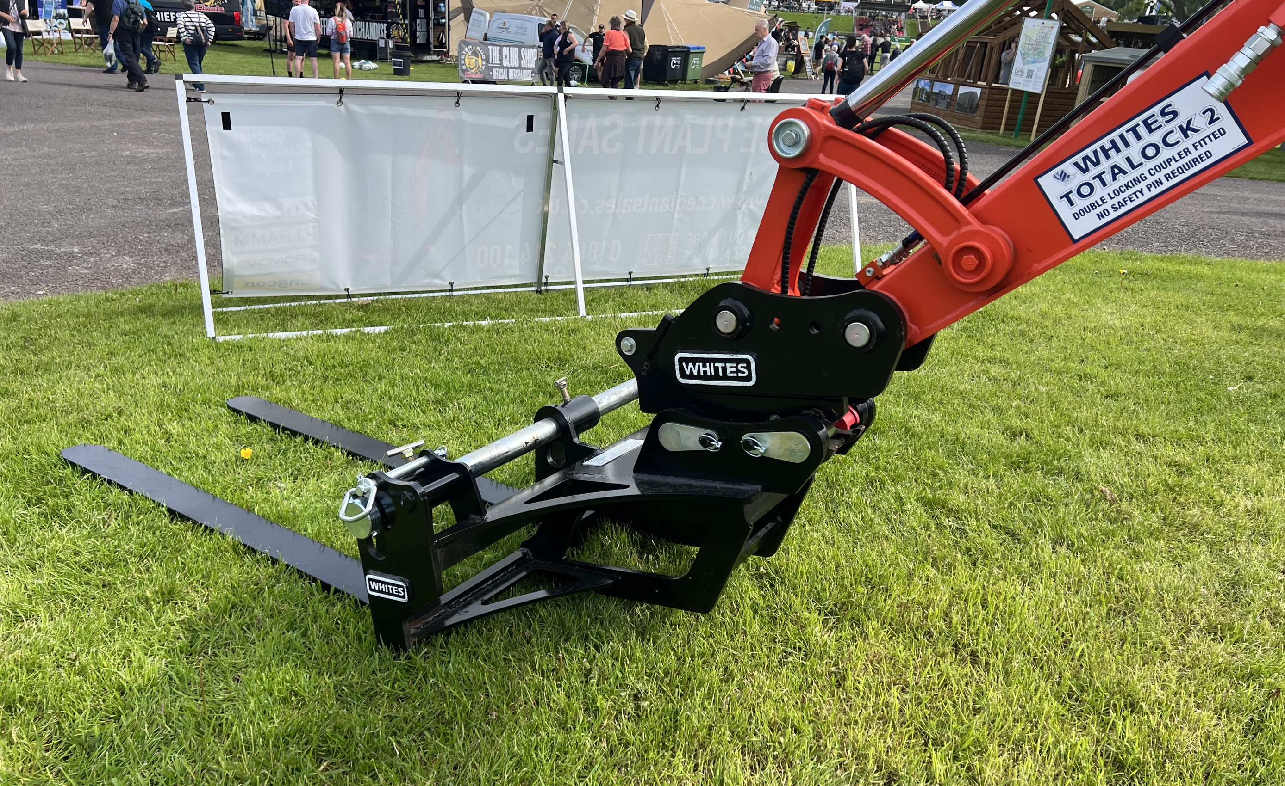
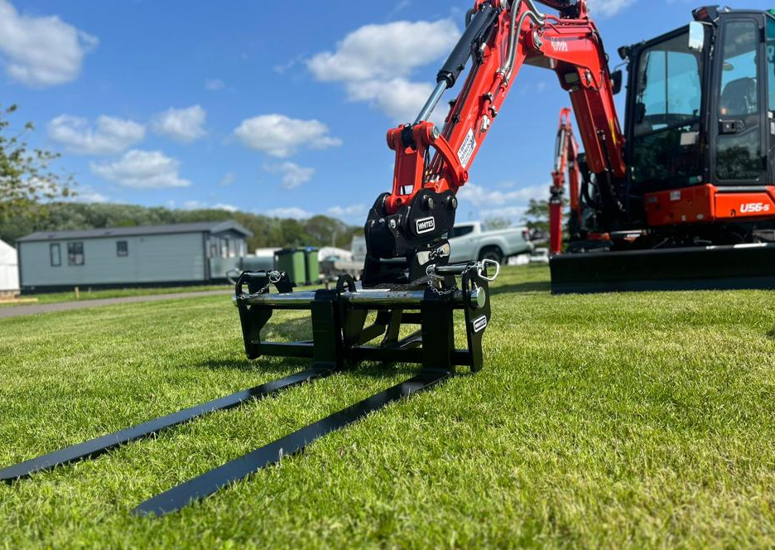
EXCAVATOR
PALLET
FORKS
FEATURES
Floating & Fixed Fork options
Floating Forks include tie backs for safe transportation
Floating Bar on Floating Fork - ideal for uneven terrain
Load guard options
Various fork length available
Suitable for a variety of machine capacities
WHITES MATERIAL HANDLING
17 - 19 EMERY ROAD
BRISTOL
BS4 5PF
0117 972 0006
WWW.WHITESMH.CO.UK
SALES@WHITESMH.CO.UK

