Slide 1
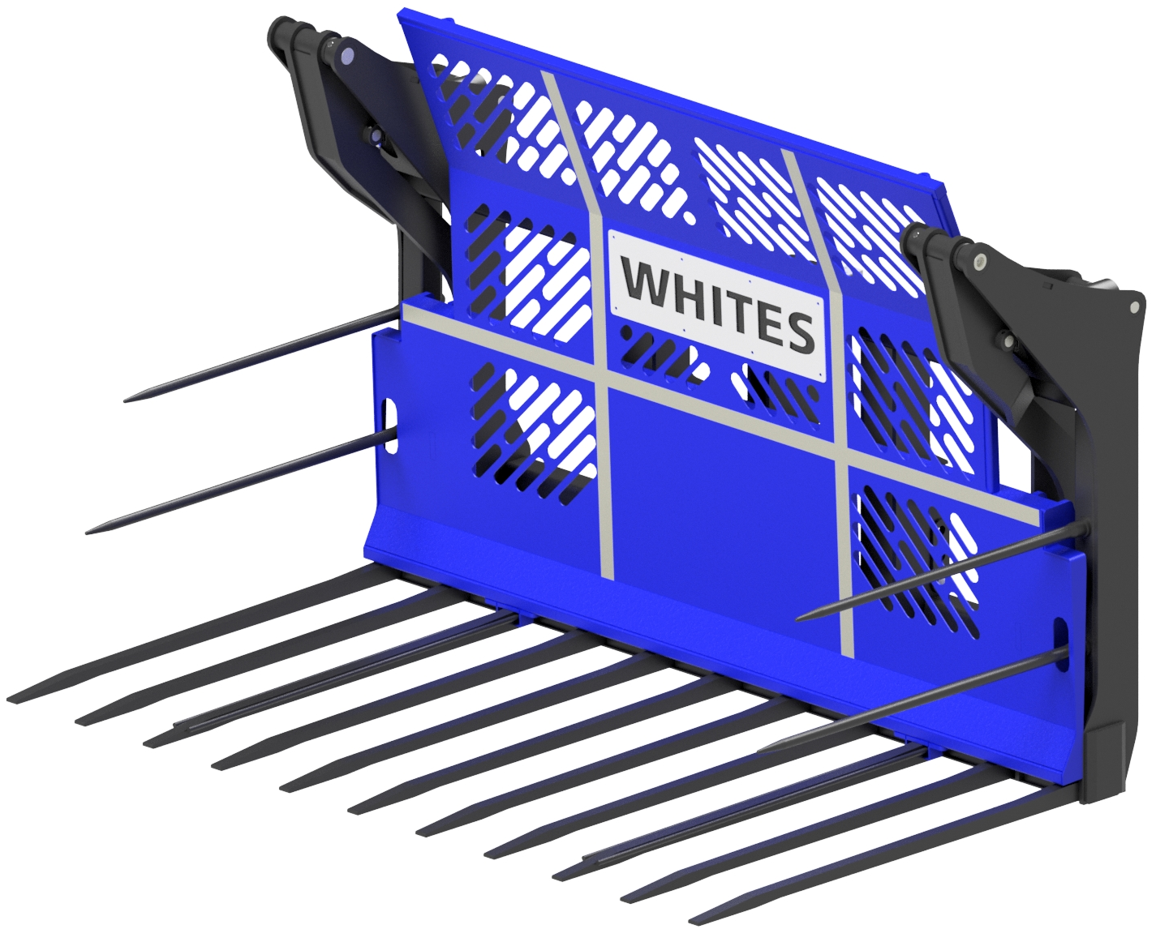
BUCKRAKES
FEATURES
1650mm long Hardox tines
200 x 100mm tine holder
Crab retention for gate movement
Double side tines
Hardened base and side wear plates
Laser cut gate – great strength and visibility
High capacity hydraulic cylinders
Three point linkage
Reflective strips
Optional personalised nameplate
Optional wheeled loader bolt on brackets
WHITES MATERIAL HANDLING
17 - 19 EMERY ROAD
BRISTOL
BS4 5PF
0117 972 0006
WWW.WHITESMH.CO.UK
SALES@WHITESMH.CO.UK

