Slide 1
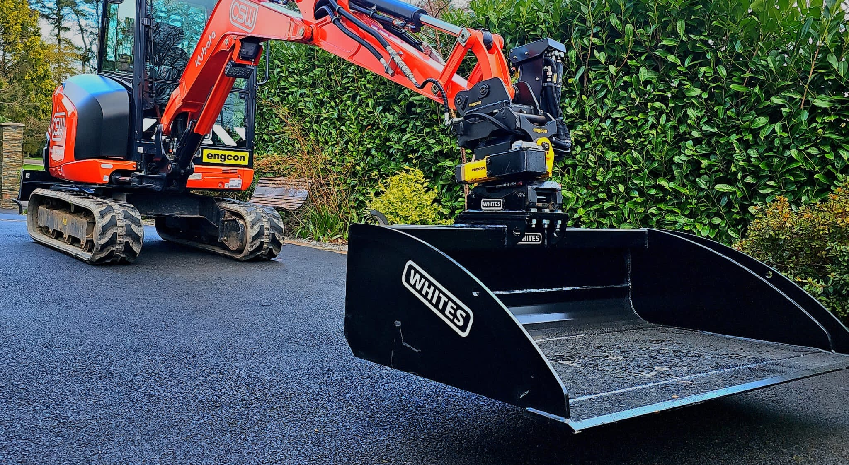
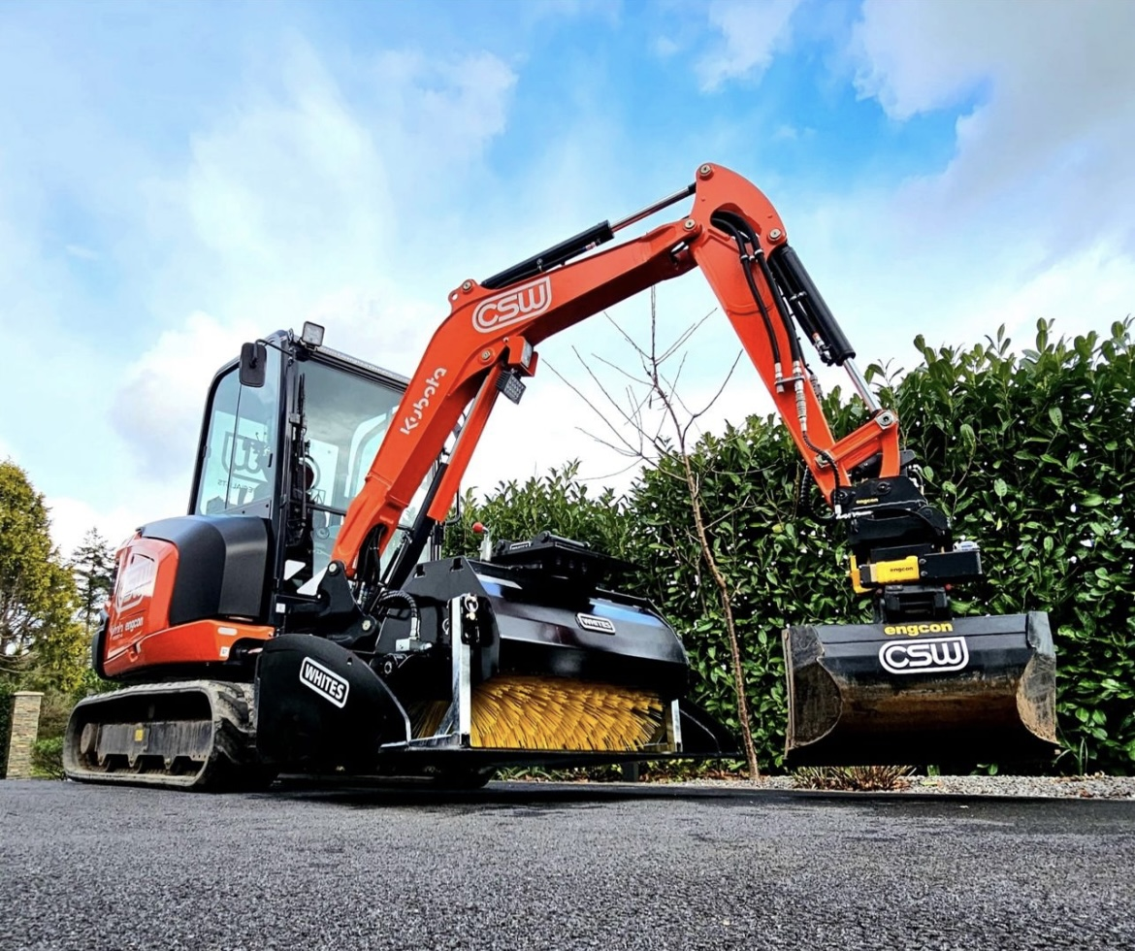
BLADE
RUNNER
FEATURES
Add versatility to your machine
Connects via blade or direct mount to coupler / machine
Universal fitment
Safely transport buckets / attachments & products
Safely store your Tiltrotator
WHITES MATERIAL HANDLING
17 - 19 EMERY ROAD
BRISTOL
BS4 5PF
0117 972 0006
WWW.WHITESMH.CO.UK
SALES@WHITESMH.CO.UK

Slide 2
BLADE
RUNNER
Part Number | Weight Range | A) Depth | B) Height | C) Weight Range
ETB1500-3 | 2-4T | 450mm | 1110mm | 1500mm
ETB1980-5 | 5-6T | 668mm | 1140mm | 1980mm
ETB1980-8 | 7-9T | 668mm | 1260mm | 1980mm
WHITES MATERIAL HANDLING
17 - 19 EMERY ROAD
BRISTOL
BS4 5PF
0117 972 0006
WWW.WHITESMH.CO.UK
SALES@WHITESMH.CO.UK

